Slide 1

LEGAL, ETHICAL, AND PROFESSIONAL ISSUES IN INFORMATION SECURITY
BUENAFE, MICHOLO JOAQUIN
GERENTE, JAY ANN ROSE
VERGARA, JHUDE

Slide 2
Topic Overview
Professional Issues
01
04
Legal Issues
MS DOS
02
05
Ethical Issues
QUIZ
03
06
Information Security
Professional Issues in Information Security
Legal Issues in Information Security
Command Prompts
Ethical Issues in Information Security
Assessment

Slide 3
LEGAL ISSUES IN INFORMATION SECURITY

Slide 4
Brain Teasers First!

Slide 5




Brain Teasers First!
4 Pics, Guess the Words
_ _ _ _ _ _ _ _ _ _ _
_ _ _ _ _ _ _

Slide 6
Brain Teasers First!
4 Pics, Guess the Words
I N F O R M A T I O N
S E C U R I T Y

Slide 7
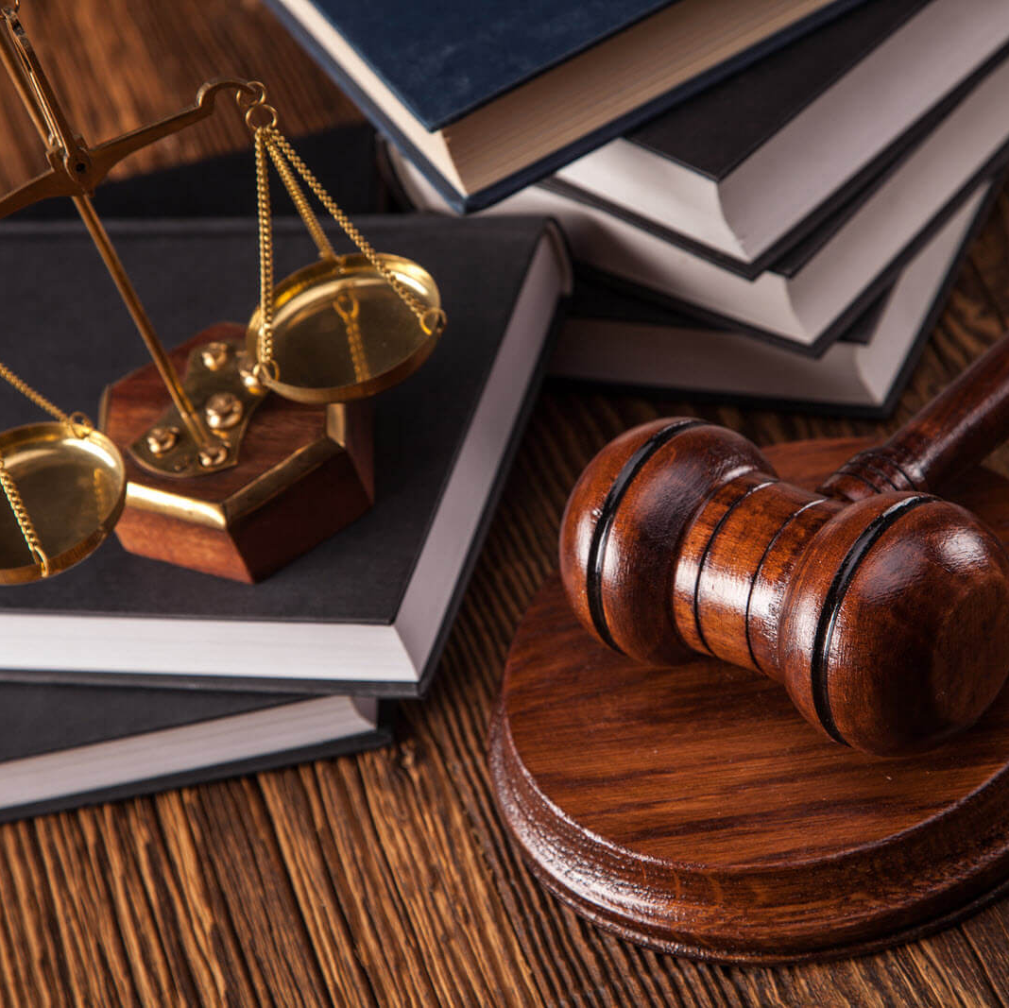

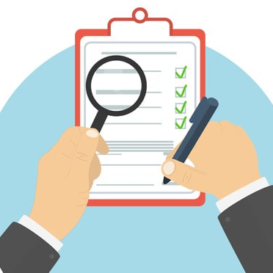

Brain Teasers First!
4 Pics, Guess the Words
_ _ _ _ _

Slide 8
Brain Teasers First!
4 Pics, Guess the Words
L E G A L

Slide 9


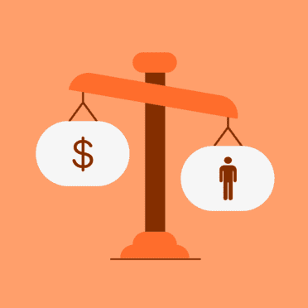

Brain Teasers First!
4 Pics, Guess the Words
_ _ _ _ _ _

Slide 10
Brain Teasers First!
4 Pics, Guess the Words
E T H I C S

Slide 11


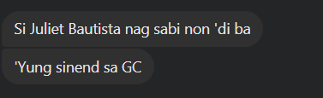

Brain Teasers First!
4 Pics, Guess the Words
_ _ _ _ _ _

Slide 12
Brain Teasers First!
4 Pics, Guess the Words
I S S U E S

Slide 13

“Security isn’t something you buy, it’s something you do, and it takes talented people to do it right”
- Nick McCorvy

Slide 14
Legal Laws
Refer to the laws and regulations that govern the collection, use, storage, and protection of information.
These laws establish the framework for what is considered acceptable and legal behavior in the handling of sensitive data.

Slide 15
Data Protection Laws
Compliance with GDPR and HIPAA is crucial for organizations, ensuring data protection, obtaining consent, and respecting individuals' rights. Non-compliance may result in penalties and reputational damage, necessitating ongoing adaptation to legal requirements.

Slide 16
Privacy Laws
Privacy laws govern how personal information should be handled and protected. Violating privacy laws can result in legal actions, fines, or other penalties.

Slide 17
Intellectual Property Laws
Protecting intellectual property is a legal consideration. Unauthorized access, use, or disclosure of copyrighted materials or proprietary information can lead to legal action.

Slide 18
Cybercrime Laws
Engaging in unauthorized access, hacking, or other malicious activities is prohibited by cybercrime laws. Perpetrators may face criminal charges and legal consequences.

Slide 19
Accessibility Laws
Ensuring that information systems are accessible to individuals with disabilities is a legal requirement in many jurisdictions.

Slide 20
In conclusion, handling legal issues in information security means following rules to protect data, respect privacy, and keep promises. It's crucial to comply with laws and standards, not just for legal reasons but to build trust in the digital world. Recognizing and addressing these legal considerations is essential for a secure and reliable digital presence.

Slide 21
Questions?

Slide 22
ETHICAL ISSUES IN INFORMATION SECURITY

Slide 23
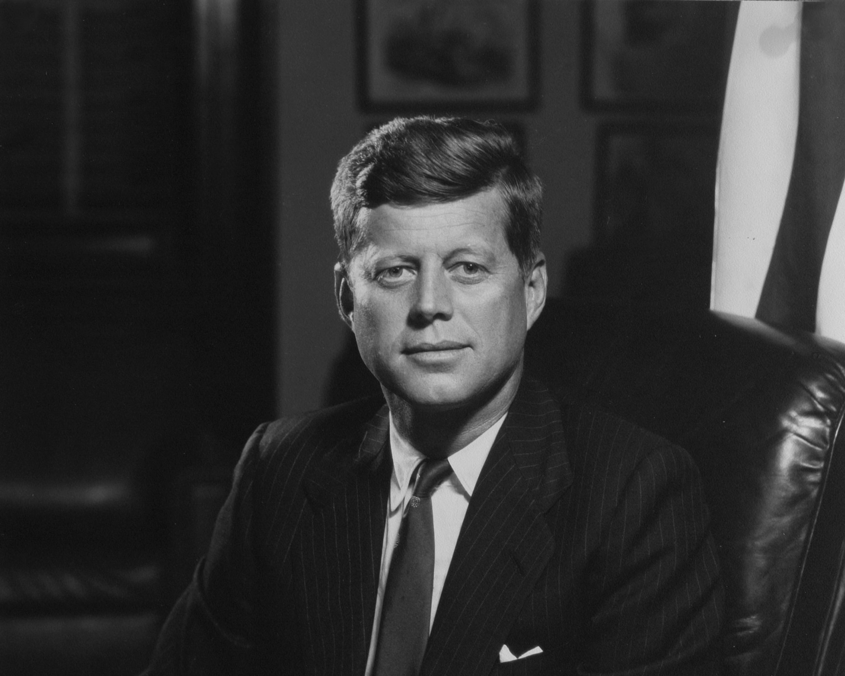
“Man is still the most extraordinary computer of all ”
- John Kennedy

Slide 24
Brain Teasers Again!

Slide 25
Brain Teasers First!
Unscramble the Words
S L W A

Slide 26
Brain Teasers First!
Unscramble the Words
L A W S

Slide 27
Brain Teasers First!
Unscramble the Words
O M C A M D M E S T N N

Slide 28
Brain Teasers First!
Unscramble the Words
C O M M A N D M E N T S

Slide 29
Brain Teasers First!
Unscramble the Words
Z E I R O U A T H

Slide 30
Brain Teasers First!
Unscramble the Words
A U T H R O R I Z E

Slide 31
Brain Teasers First!
Unscramble the Words
B A E H I O V R

Slide 32
Brain Teasers First!
Unscramble the Words
B E H A V I O R

Slide 33
Laws and Ethics in Information Security
Laws - are rules that mandate or prohibit certain behavior in society.
Ethics - define socially acceptable behaviors.

Slide 34
Ethics and Information Security
Many professional groups have explicit rules governing ethical behavior in the workplace.
Information technology and the information security field in particular do not have a binding code of ethics.
Professional associations and certification agencies work to establish codes of ethics.
Can prescribe ethical conduct
Do not always have the ability to ban violators from practice in field.

Slide 35
TEN COMMANDMENTS OF COMPUTER ETHICS
From The Computer Ethics Institute
1. Thou shalt not use a computer to harm other people.
2. Thou shalt not interfere with other people’s computer work.
3. Thou shalt not snoop around in other people’s computer files.
4. Thou shalt not use a computer to steal.
5. Thou shalt not use a computer to bear false witness.
6. Thou shalt not copy or use proprietary software for which you have not paid.
7. Thou shalt not use other people’s computer resources without authorization or proper compensation.
8. Thou shalt not appropriate other people’s intellectual output.
9. Thou shalt think about the social consequences of the program you are writing or the system you are designing.
10. Thou shalt always use a computer in ways that ensure consideration and respect for your fellow humans.

Slide 36
Ethics Differences Across Cultures
Cultural differences create difficulty in determining what is ethical and what is not ethical.
Difficulties arise when a nationality’s ethical behavior conflicts with the ethics of another national group.
Scenarios are grouped into:
Software License Infringement.
Illicit Use.
Misuse of Corporate Resources

Slide 37
ETHICS AND EDUCATION
Overriding factor in leveling ethical perceptions within a small population is education
Employees must be trained in the expected behaviors of an ethical employee, especially in areas of information security.
Proper ethical training is vital to creating informed, well-prepared, and low-risk system users.

Slide 38
DETERRING UNETHICAL AND ILLEGAL BEHAVIOR
Three general causes of unethical and illegal behavior: ignorance, accident, intent.
Deterrence: best method for preventing an illegal or unethical activity; e.g., laws, policies, technical controls.
Laws and policies only deter if three conditions are present:
Fear of penalty.
Probability of being caught.
Probability of penalty being administered.

Slide 39
Questions?

Slide 40
PROFESSIONAL ISSUES IN INFORMATION SECURITY

Slide 41
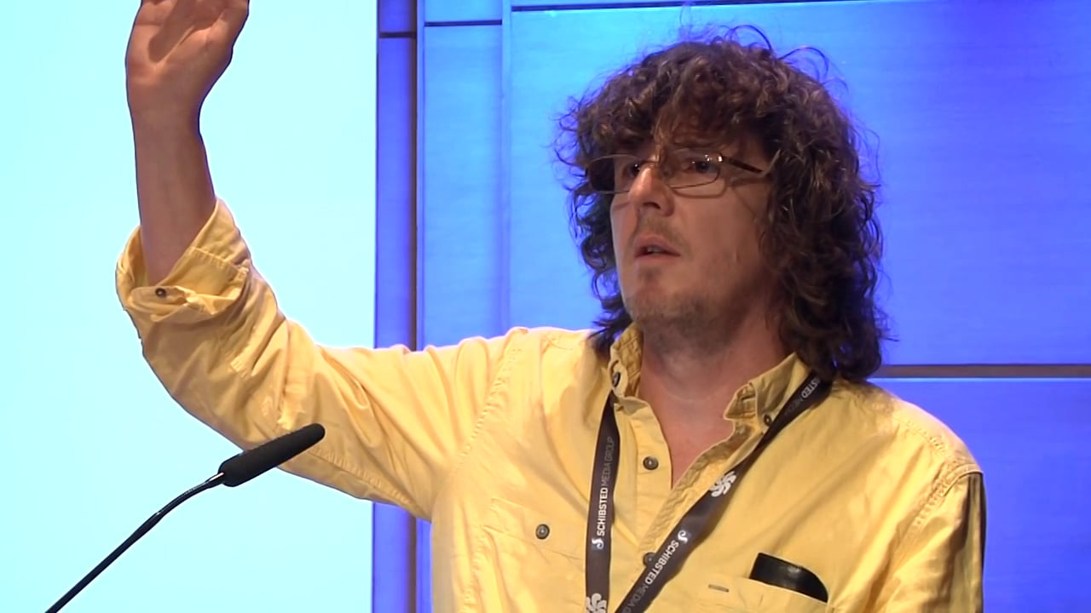
“Programming is not about typing, it is about thinking what you’re going to type”
- Rich Hickey

Slide 42
Brain Teasers Again?

Slide 43
Later! Let’s proceed to discussion

Slide 44
What is Information Security?
- Information security (sometimes referred to as InfoSec) covers the tools and processes that organizations use to protect information.
- InfoSec protects sensitive information from unauthorized activities, including inspection, modification, recording, and any disruption or destruction. The goal is to ensure the safety and privacy of critical data such as customer account details, financial data or intellectual property.

Slide 45
Information Security Professionals?
- They play a critical role in protecting organizations from security threats, both internal and external.
- They are governed with legal and code of ethical standards. They must possess intricate knowledge on their field and undergo up-to-date training with the latest security threats and patches. They must also comply to data privacy laws and respect the privacy of every human they’re handling with.

Slide 46
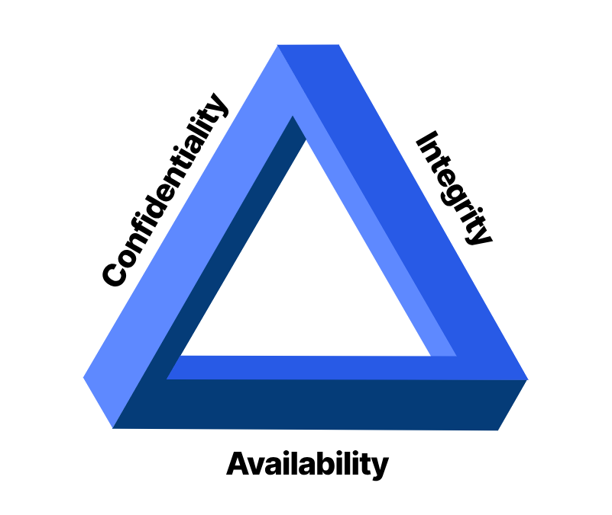
INFOSEC PROFESSIONALS MUST POSSES THESE THREE
Confidentiality
Integrity
Availability
It measures are designed to prevent unauthorized disclosure of information.
ensures that data is accurate and reliable and is not modified incorrectly, whether accidentally or maliciously.
protection of a system’s ability to make software systems and data fully available when a user needs it (or at a specified time).

Slide 47
Professional Issues
Several professional organizations have established code of professional ethics
Every professionals must understand the law like of keeping privacy such as Republic Act No. 10173, or also known as ________
Responsibility of security professionals to act ethically and according to policies of employer, professional orgranization, and laws of society

Slide 48
Professional Issues: Challenges and Solution
Bridging the Skills Gap: The rapid evolution of technology and threats creates a constant demand for new skills, leaving many positions unfilled.
Upskilling and Reskilling: Encourage continuous learning through certifications, training programs, and knowledge-sharing initiatives.
Collaboration with Academia: Establish partnerships to align academic programs with industry needs and bridge the knowledge gap.
Diversity and Inclusion: Promote diverse talent pipelines by encouraging participation from underrepresented groups in STEM fields.

Slide 49
Professional Issues: Challenges and Solution
Evolving Regulations and Standards: Keeping up with the ever-changing legal and regulatory landscape can be overwhelming
Continuous Learning: Stay updated on legal developments and emerging regulations through industry publications and professional organizations.
Seek Expert Guidance: Consult with legal and compliance professionals when dealing with complex regulatory issues.
Advocate for Clear and Practical Regulations: Engage with policymakers to advocate for clear, practical, and enforceable regulations.

Slide 50
Professional Issues: Challenges and Solution
Combating Job Stress and Burnout: The high-pressure, high-stakes nature of the job can lead to stress, burnout, and job dissatisfaction.
Work-Life Balance: Promote healthy work-life boundaries through flexible scheduling, mental health awareness programs, and stress management techniques.
Strong Support Systems: Foster a culture of open communication and peer support within security teams.
Recognition and Appreciation: Acknowledge and reward the valuable contributions of information security professionals.

Slide 51
Professional Issues: Challenges and Solution
Ethical Dilemmas and Moral Compasses: Professionals may face situations where ethical obligations clash with organizational interests or client demands.
Strong Ethical Frameworks: Establish clear ethical codes of conduct and provide training on identifying and navigating ethical dilemmas.
Whistleblower Protections: Ensure safe and secure channels for reporting unethical practices without fear of retaliation.
Transparency and Accountability: Promote open communication and hold all stakeholders accountable for ethical behavior.

Slide 52
Professional Issues: Challenges and Solution
Career Development and Growth: Staying competitive and finding opportunities for advancement in a dynamic field can be difficult.
Networking and Community Building: Actively engage with the information security community through conferences, online forums, and professional organizations.
Mentorship and Sponsorship: Seek guidance and support from experienced professionals to accelerate your career growth.
Specialization and Expertise: Develop deep expertise in specific areas of information security to enhance your value proposition.

Slide 53
ORGANIZATIONAL LIABILITY
Liability is legal obligation of an entity; includes legal obligation to make restitution for wrongs committed
Organization increases liability if it refuse to take measures known as due care
Due diligence require that an organization make valid effort to protect others and continually maintain that level of efforts

Slide 54
Questions?

Slide 55
DOS COMMANDS

Slide 56
COMMAND PROMPT
DOS COMMANDS
The Command Prompt in Windows provides access to over 280 commands. These commands are used to do certain operating system tasks from a command-line interpreter instead of the graphical Windows interface we use most of the time.

Slide 57
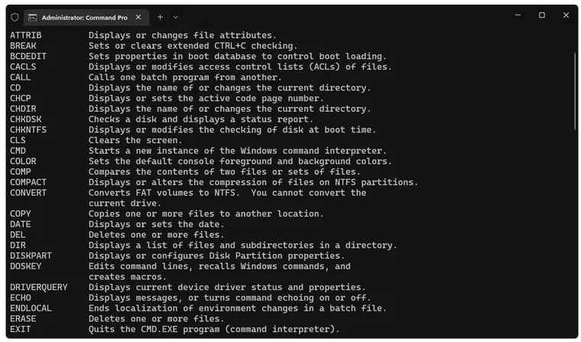
COMMAND PROMPT

Slide 58
COMMAND PROMPT
CD
DIR
CLS
MD
REN
RD
ECHO
DEL
COPY
COLOR
EXIT

Slide 59
Brain Teasers Again?

Slide 60
No, because it’s QUIZ TIME!

Slide 61
Thank You!

